Slide 1
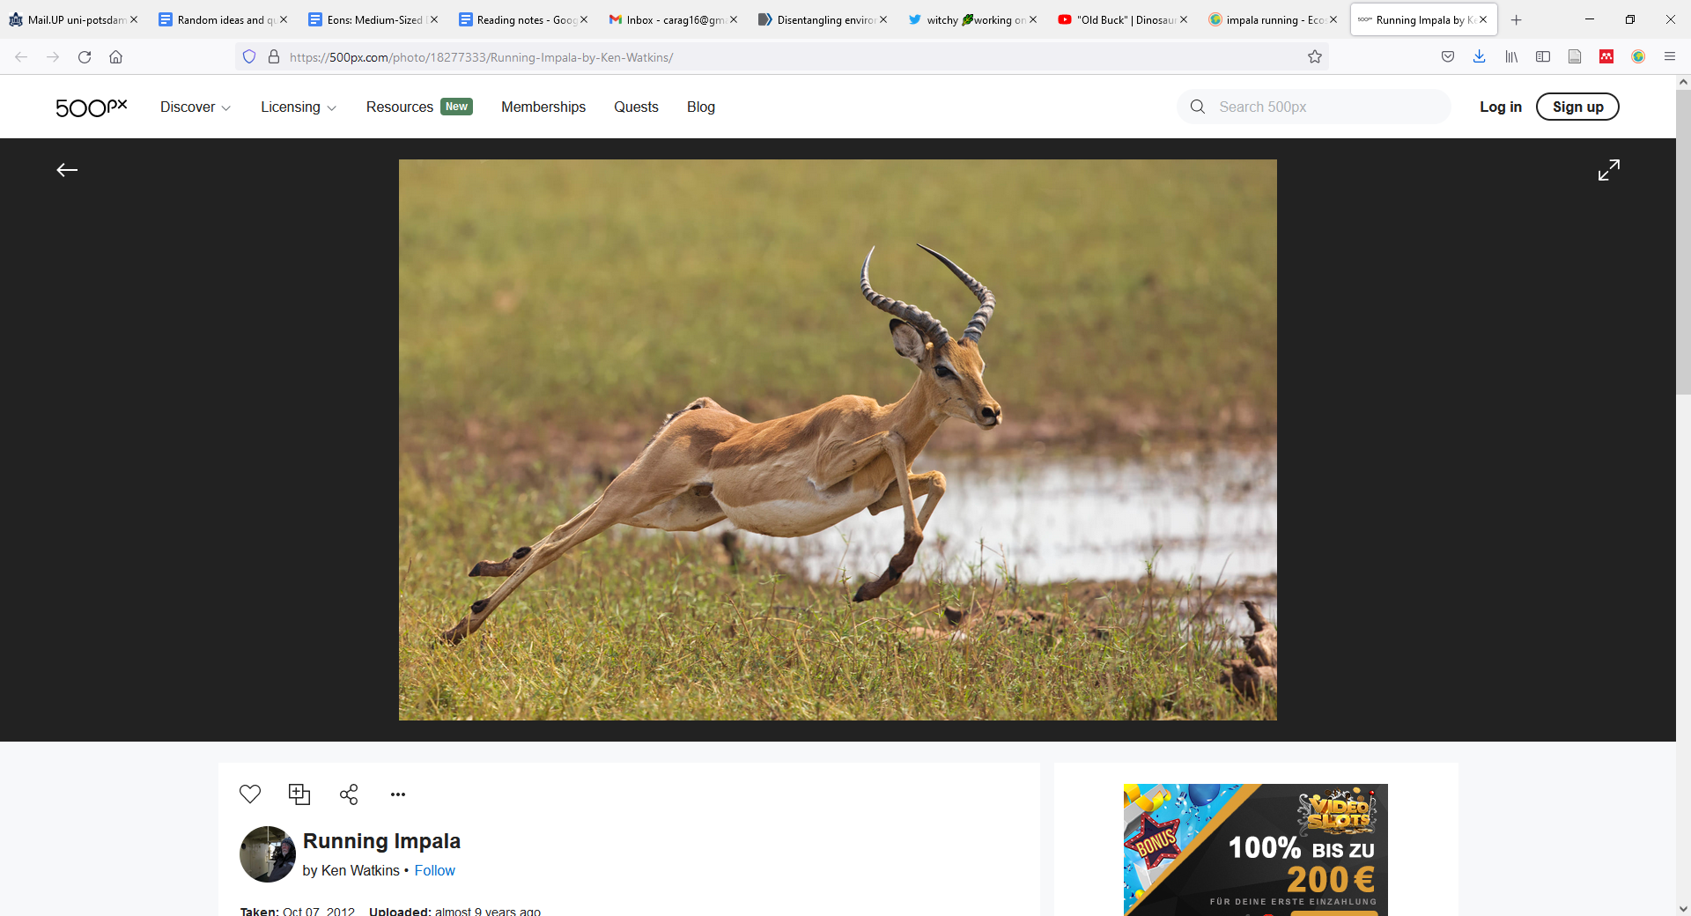
From individual energetics to biodiversity patterns
Ken Watkins
iStock

Slide 2


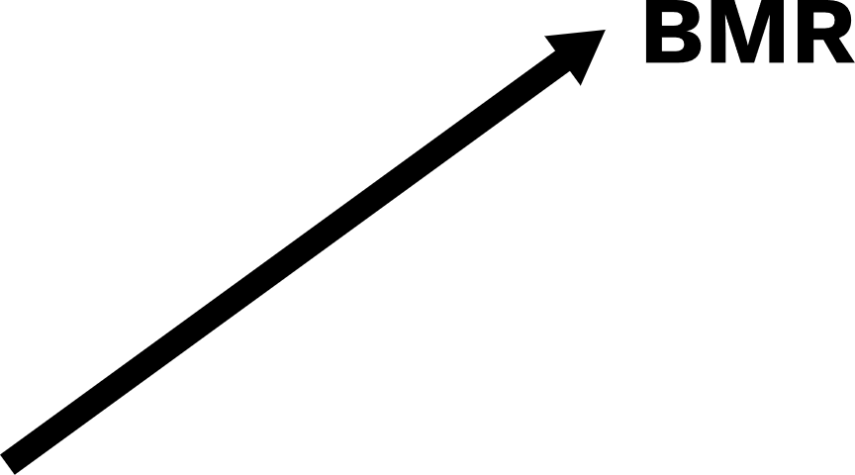




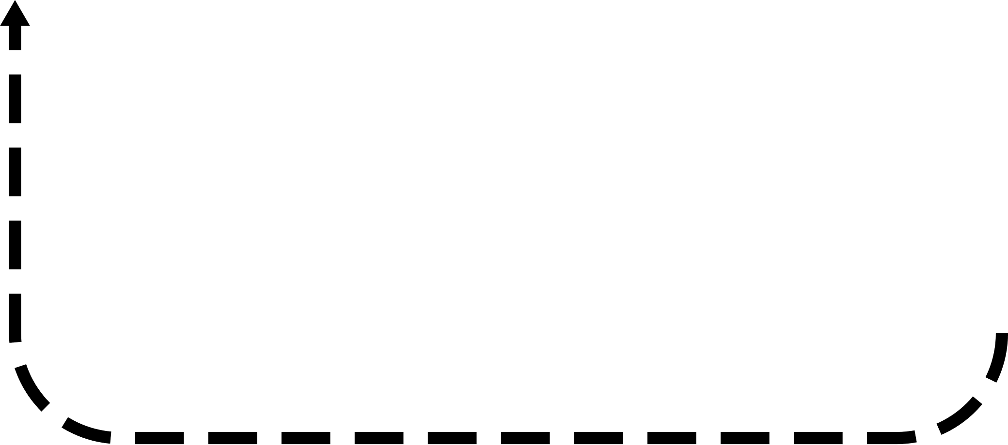

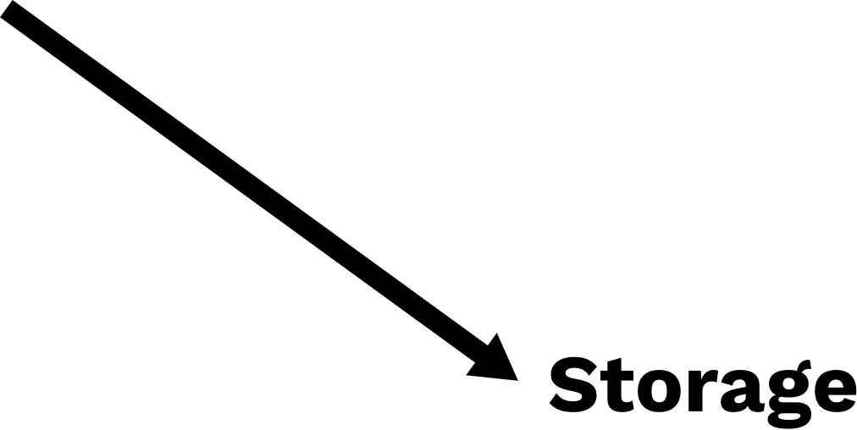


Slide 3
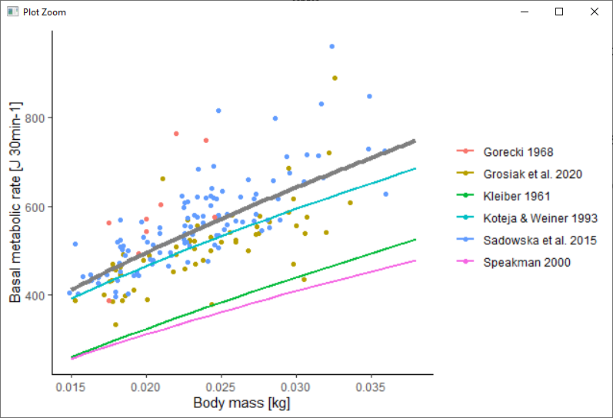
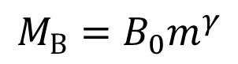
$${M_{B}=B}_{0}m^{γ}$$
Kleiber 1975; Sibly et al. 2013
Calibrated using data from Sadowska et al. 2015, Grosiak et al. 2020, & Górecki 1968

Slide 4
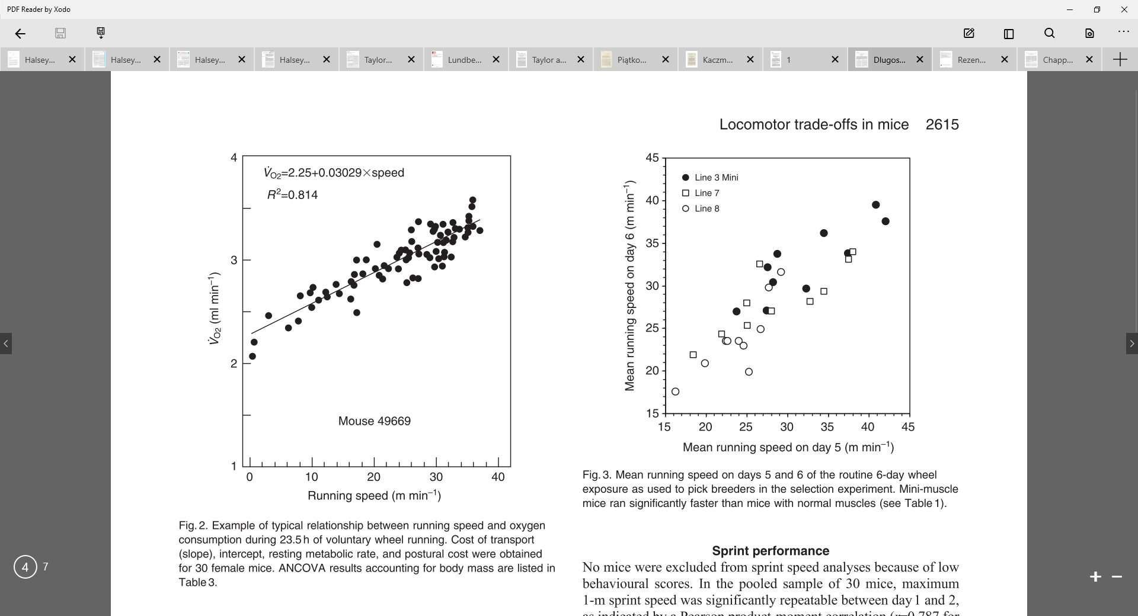
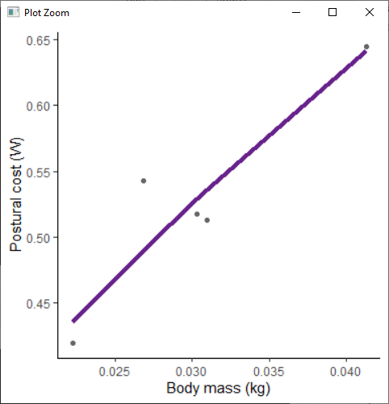
Postural costs
Incremental costs
$$M_{L}=\left(B_{pcot}m^{γ_{pcot}}+ B_{icot}m^{γ_{icot}}×m×v\right)$$
Not available as a separate component
Pontzer 2016
Three papers measured this cost explicitly for mice
(Chappell et al. 2004, Dlugosz et al. 2009 & Rezende et al. 2006)
RMR =
0.73 ml O² min^{–1}

Slide 5
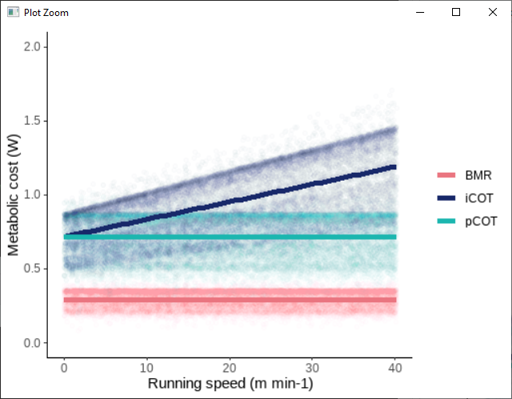
$$M_{L}=\left(B_{pcot}m^{γ_{pcot}}+ B_{icot}m^{γ_{icot}}×m×v\right)$$

Slide 6
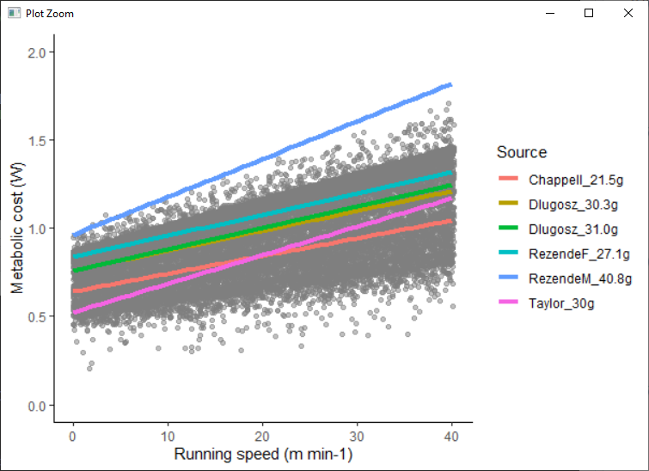
$$M_{L}=\left(B_{pcot}m^{γ_{pcot}}+ B_{icot}m^{γ_{icot}}×m×v\right)$$

Slide 7
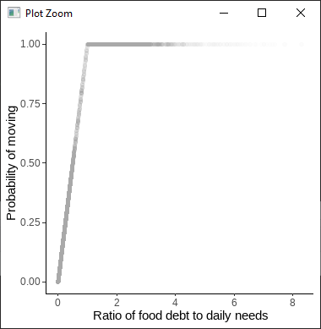
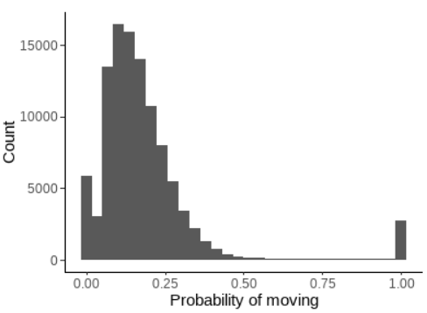
$$M_{L}=\left(B_{pcot}m^{γ_{pcot}}+ B_{icot}m^{γ_{icot}}×m×v\right)$$
Link between energy balance and activity
18.5 +- 17.1%

Slide 8
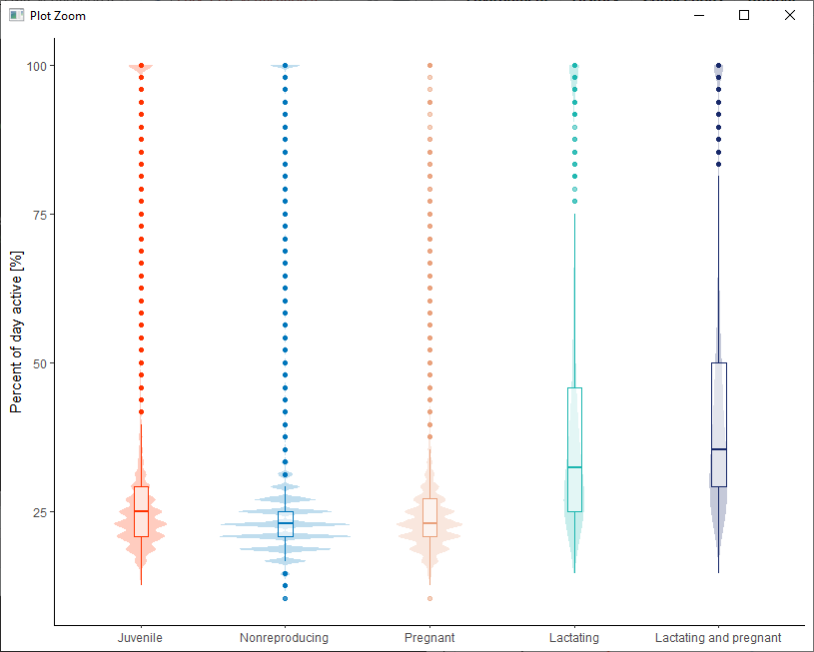
$$M_{L}=\left(B_{pcot}m^{γ_{pcot}}+ B_{icot}m^{γ_{icot}}×m×v\right)$$
Link between energy balance and activity

Slide 9
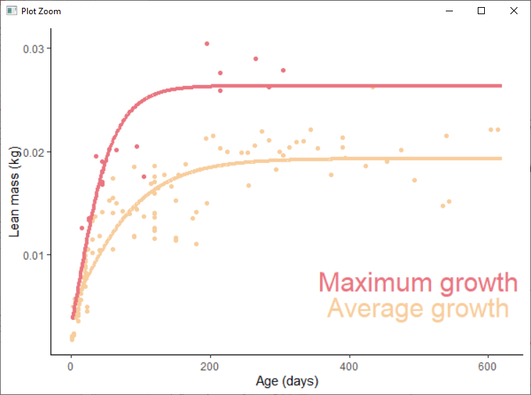
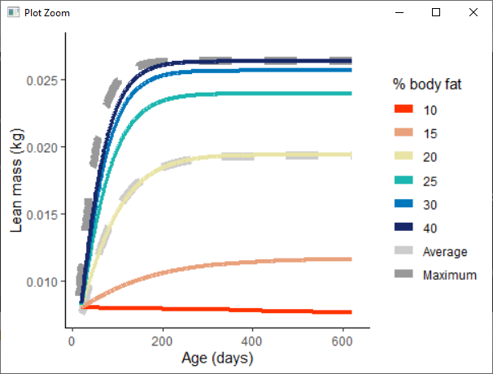
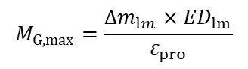
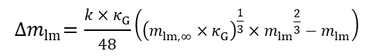
Change in mass:
$${∆m}_{lm}=\frac{k×κ_{G}}{48}\left({\left(m_{lm,∞}×κ_{G}\right)}^{\frac{1}{3}}×{m_{lm}}^{\frac{2}{3}}−m_{lm}\right)$$
Growth cost:
$$M_{G,max}=\frac{{∆m}_{lm}×{ED}_{lm}}{ε_{pro}}$$
Growth curves fit to results from six studies:
Fedyk 1974, Hansson 1991, Rudolf et al. 2017, Sawicka-Kapusta 1974, Balčiauskienė 2007, & Gębczyński 1975
With extremely large animals in
Adjusted for lean mass using fat mass in papers or the relationships in Sawicka-Kapusta 1974
Fit using Gompertz, Logistic, and Von Bertalanffy and assessed using AIC - Von Bertalanffy fit best

Slide 10
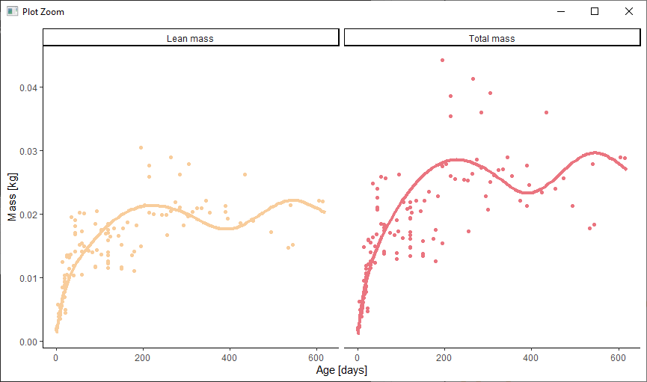
Change in mass:
$${∆m}_{lm}=\frac{k×κ_{G}}{48}\left({\left(m_{lm,∞}×κ_{G}\right)}^{\frac{1}{3}}×{m_{lm}}^{\frac{2}{3}}−m_{lm}\right)$$
Growth cost:
$$M_{G,max}=\frac{{∆m}_{lm}×{ED}_{lm}}{ε_{pro}}$$

Slide 11
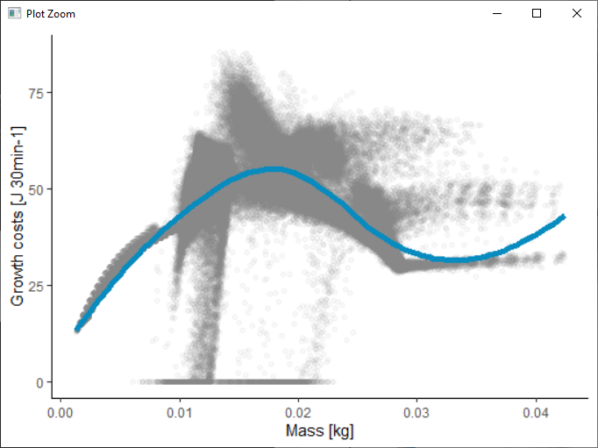
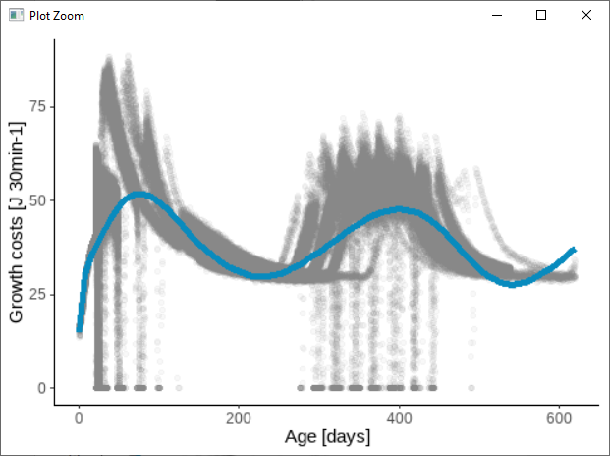
Change in mass:
$${∆m}_{lm}=\frac{k×κ_{G}}{48}\left({\left(m_{lm,∞}×κ_{G}\right)}^{\frac{1}{3}}×{m_{lm}}^{\frac{2}{3}}−m_{lm}\right)$$
Growth cost:
$$M_{G,max}=\frac{{∆m}_{lm}×{ED}_{lm}}{ε_{pro}}$$

Slide 12
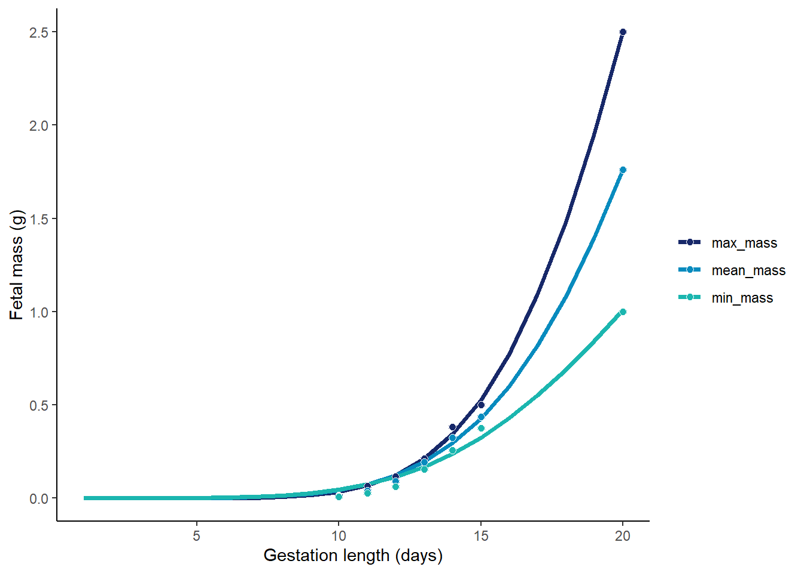
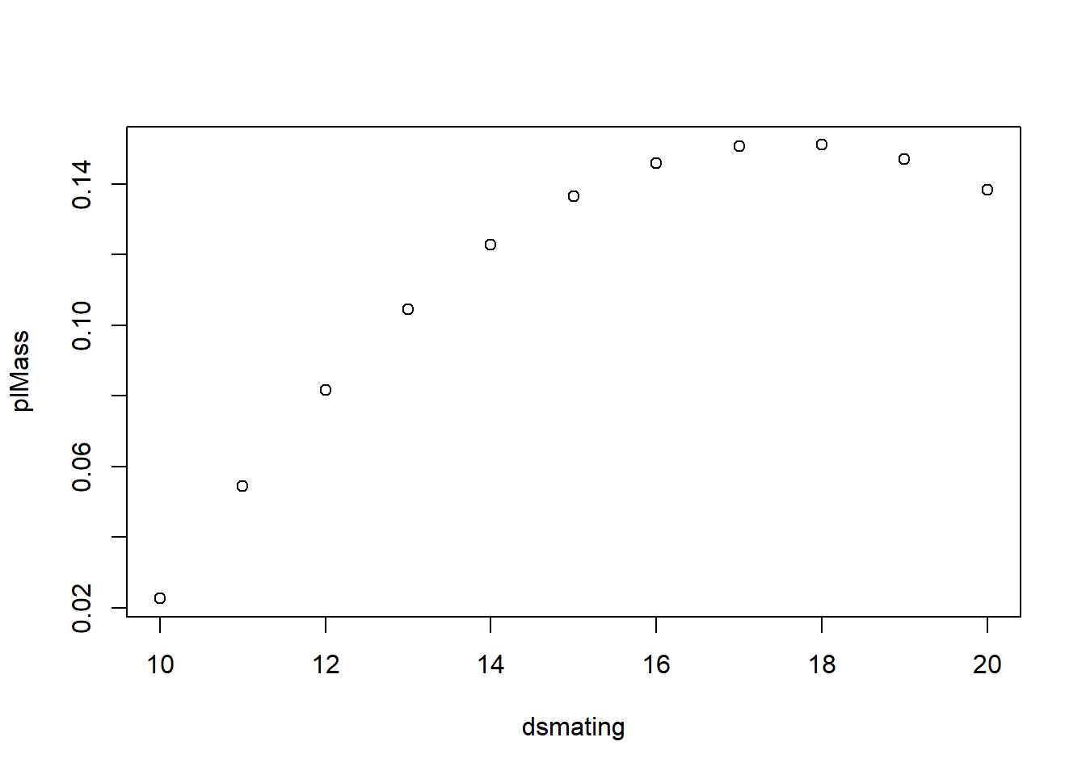
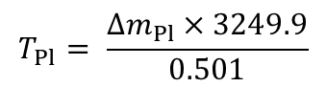

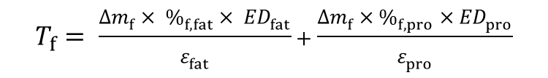
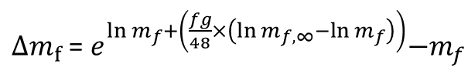
Pregnancy
$$M_{P}=\sum_{i=off \#}^{n_{off}}{\left({T_{f}}_{i}+{T_{Pl}}_{i}\right)}$$
$∆m_{f}$ =${ e}^{ln m_{f}+\left(\frac{fg}{48}×\left(\ln{m_{f,∞}}−ln m_{f}\right)\right)}−m_{f}$
$$T_{f}= \frac{∆m_{f}× \%_{f,fat}× {ED}_{fat}}{ε_{fat}}+\frac{∆m_{f}×\%_{f,pro}×{ED}_{pro}}{ε_{pro}}$$
Fetal mass
Ożdżeński and Mystkowska 1976
-Bank voles
Placental mass
Mu et al. 2008
- Lab mice
$$∆m_{Pl}=\left(−0.54180+0.07887×{age}_{gest}−0.002243×{{age}_{gest}}^{2}\right)−m_{p}$$
$$T_{Pl}= \frac{∆m_{Pl}×3249.9}{0.501}$$

Slide 13
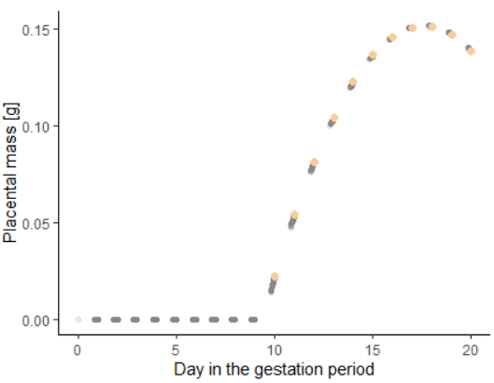
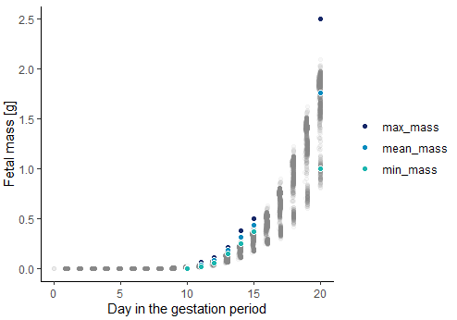
Pregnancy
$$M_{P}=\sum_{i=off \#}^{n_{off}}{\left({T_{f}}_{i}+{T_{Pl}}_{i}\right)}$$

Slide 14
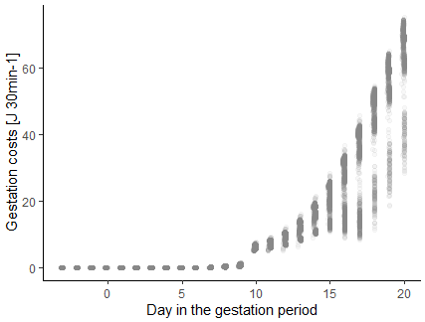
Pregnancy
$$M_{P}=\sum_{i=off \#}^{n_{off}}{\left({T_{f}}_{i}+{T_{Pl}}_{i}\right)}$$

Slide 15
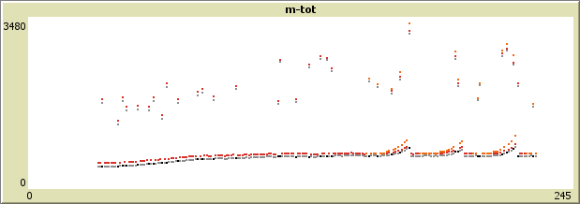
Pregnancy
$$M_{P}=\sum_{i=off \#}^{n_{off}}{\left({T_{f}}_{i}+{T_{Pl}}_{i}\right)}$$
Also increased BMR for females due to increased mass
– as in Trebatická et al. 2007

Slide 16
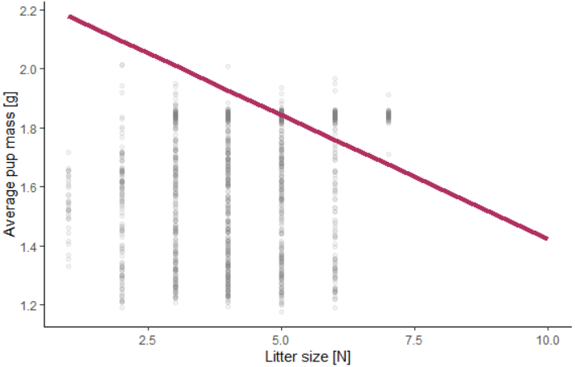
Pregnancy
From Mappes & Koskela 2004

Slide 17
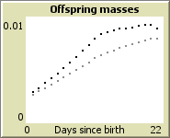
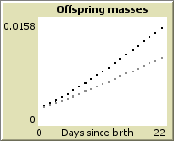
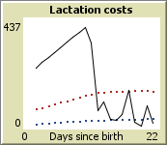
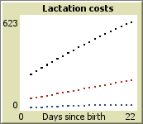

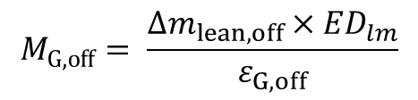
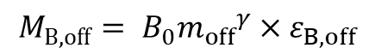
Lactation
$${M_{B,off}= B}_{0}{m_{off}}^{γ}×ε_{B,off}$$
$$M_{G,off}= \frac{∆m_{lean,off}×{ED}_{lm}}{ε_{G,off}}$$
$$M_{Lact}= \frac{\sum_{i=off \#}^{n_{off}}{{M_{B,off}}_{i}+{M_{G,off}}_{i}}}{ε_{mp}}$$
Total mass
Any extra goes to fat storage
Lean mass
Maximum
Total costs
Offspring BMR
Offspring growth

Slide 18
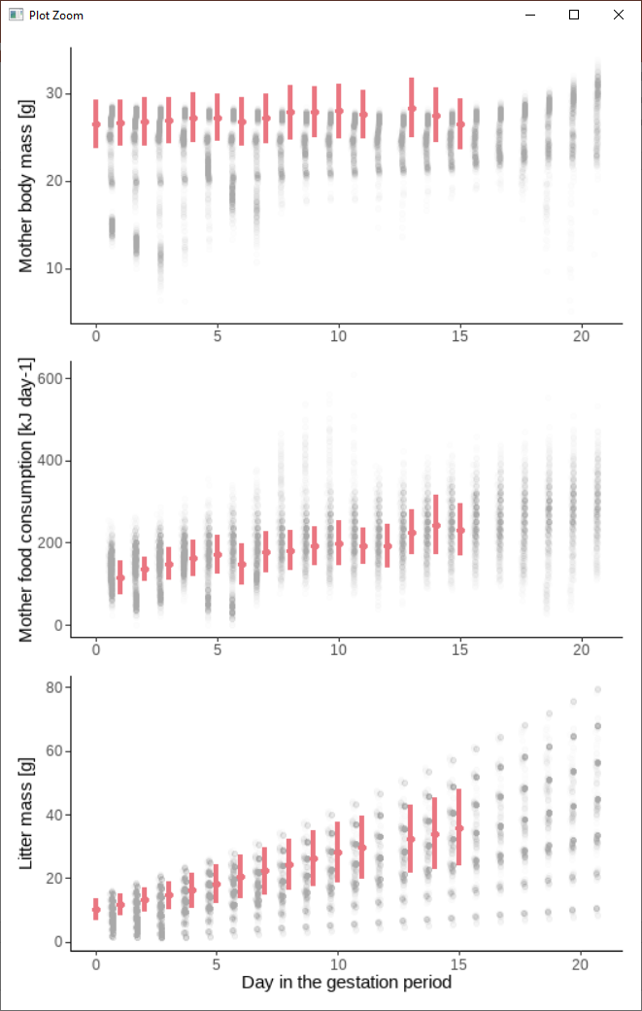
Lactation
From Sadowska et al. 2015
- for unshaved control mothers

Slide 19
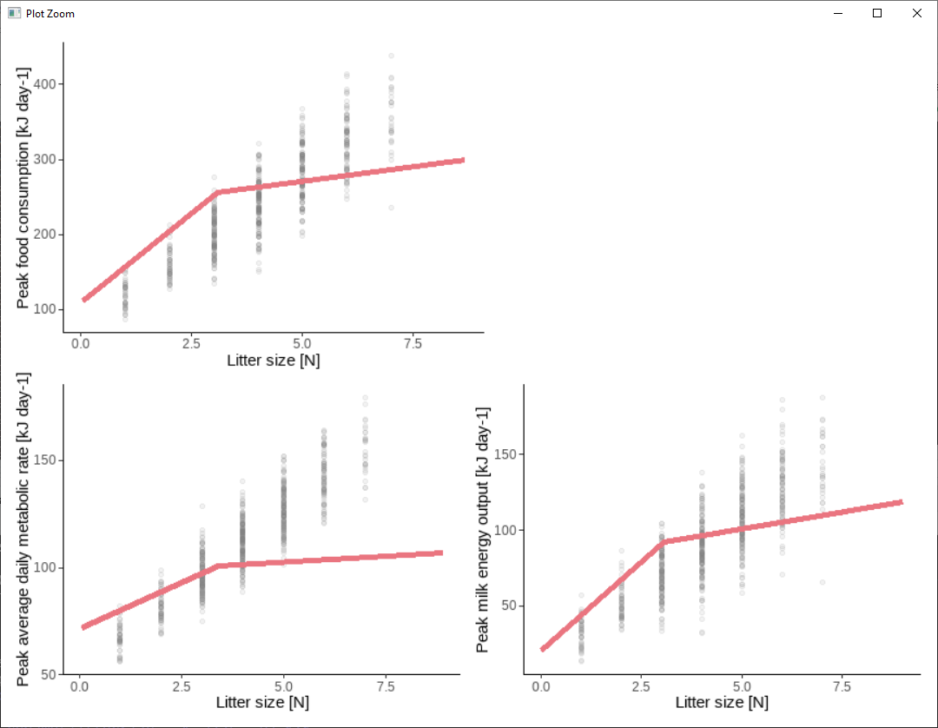
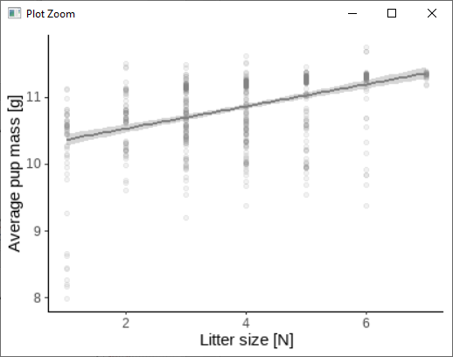
Lactation

Slide 20
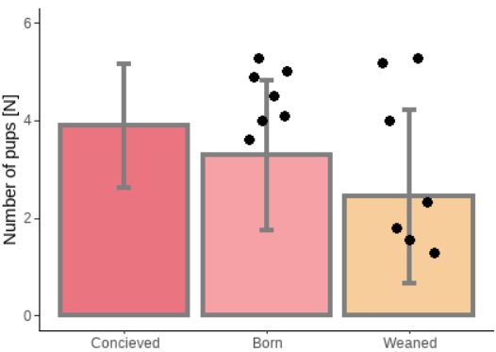
Lactation
Survival modelled as a modified version of adult survival (using separate constants for embryos and offspring)

Slide 21
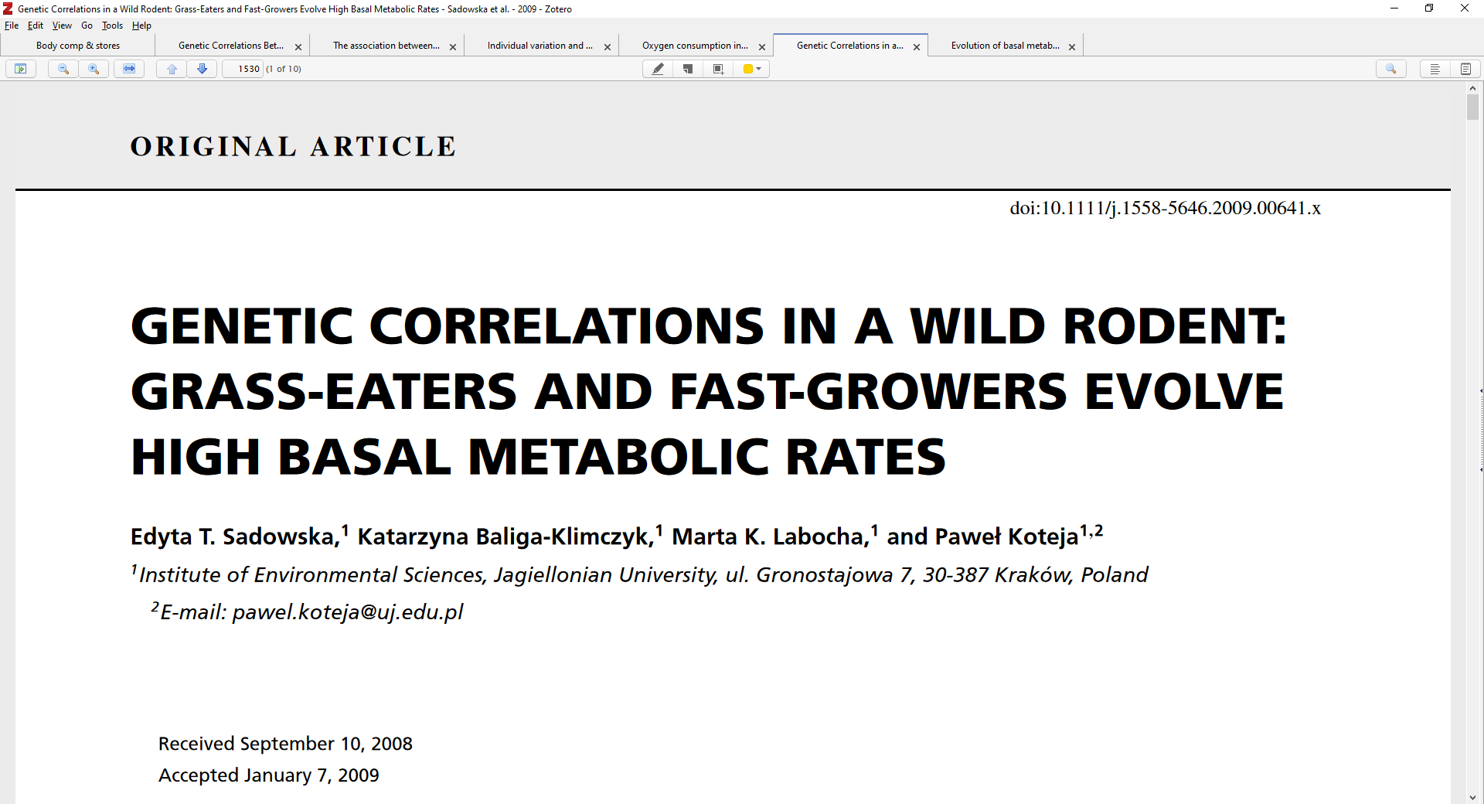
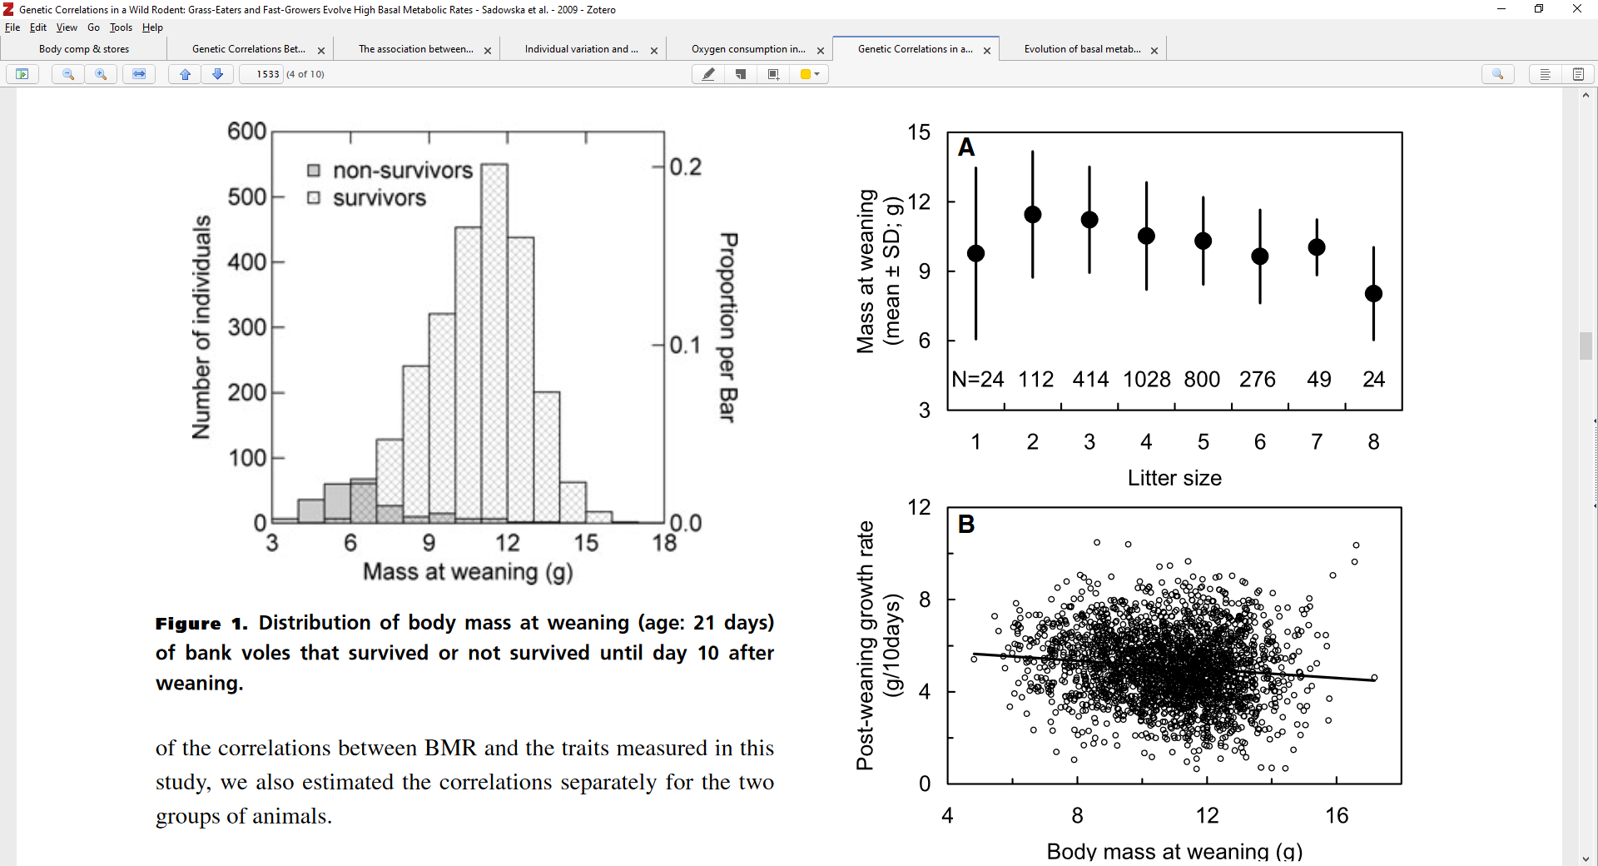
Lactation
Survival modelled as a modified version of adult survival (using separate constants for embryos and offspring)

Slide 22
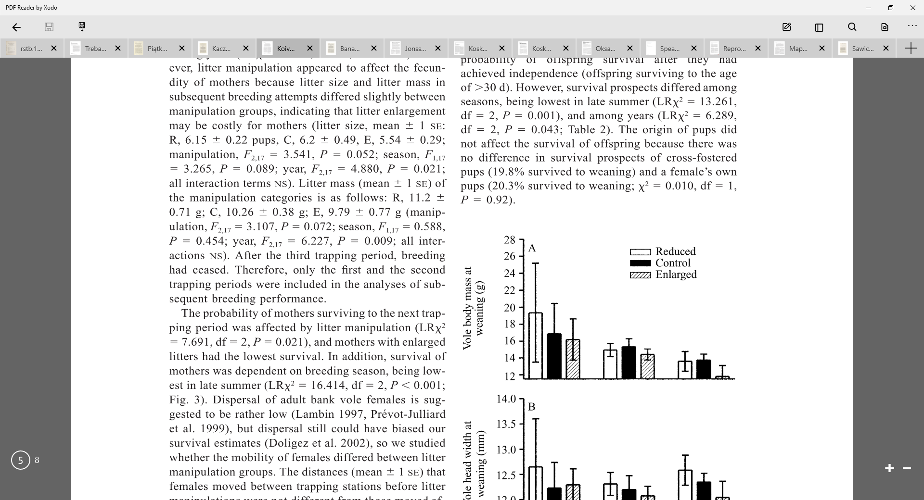
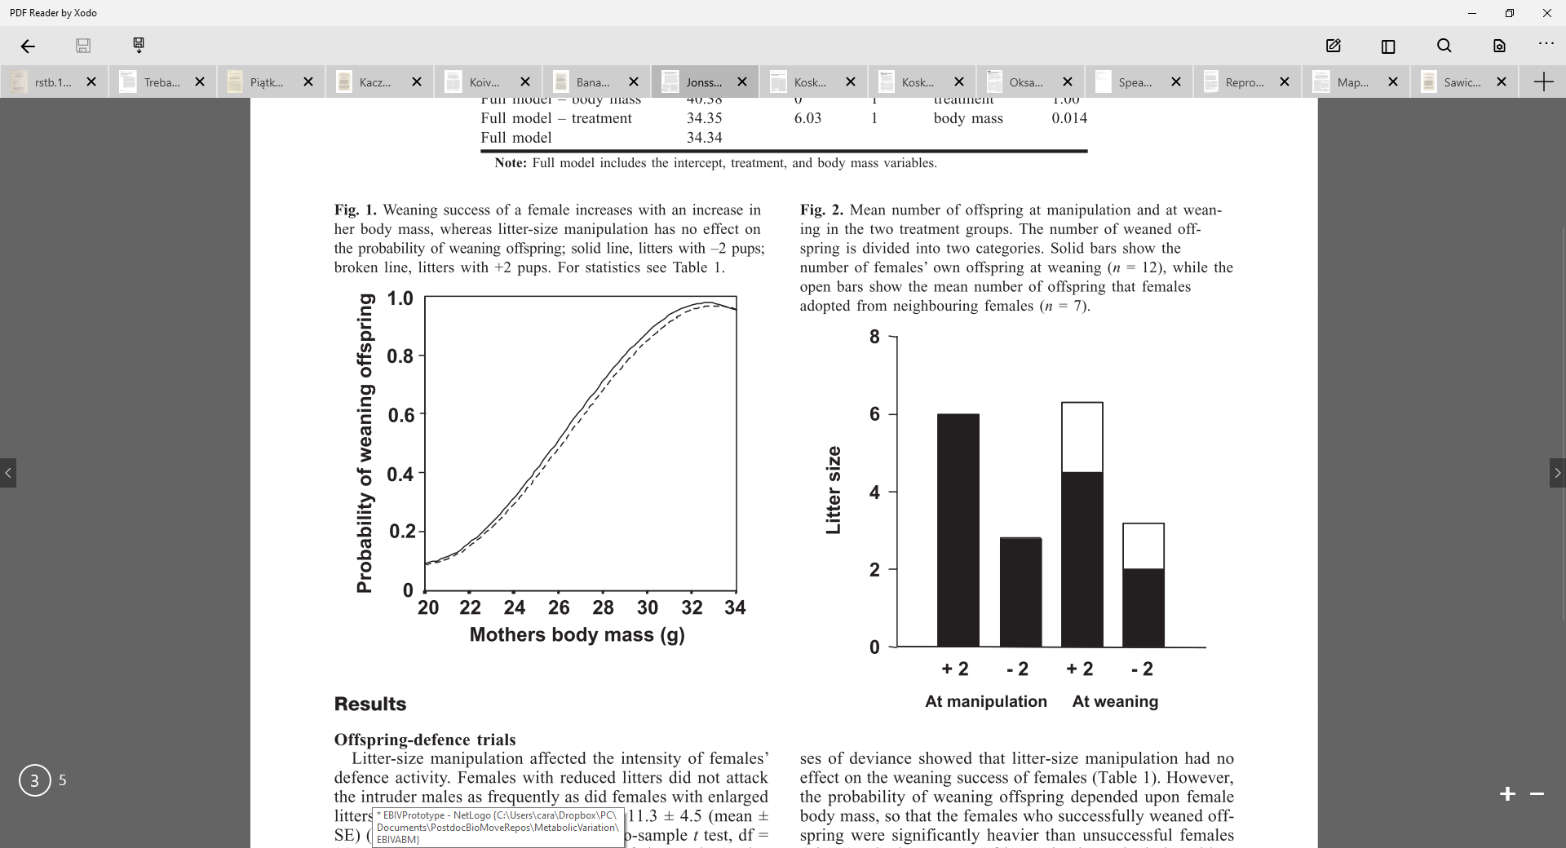
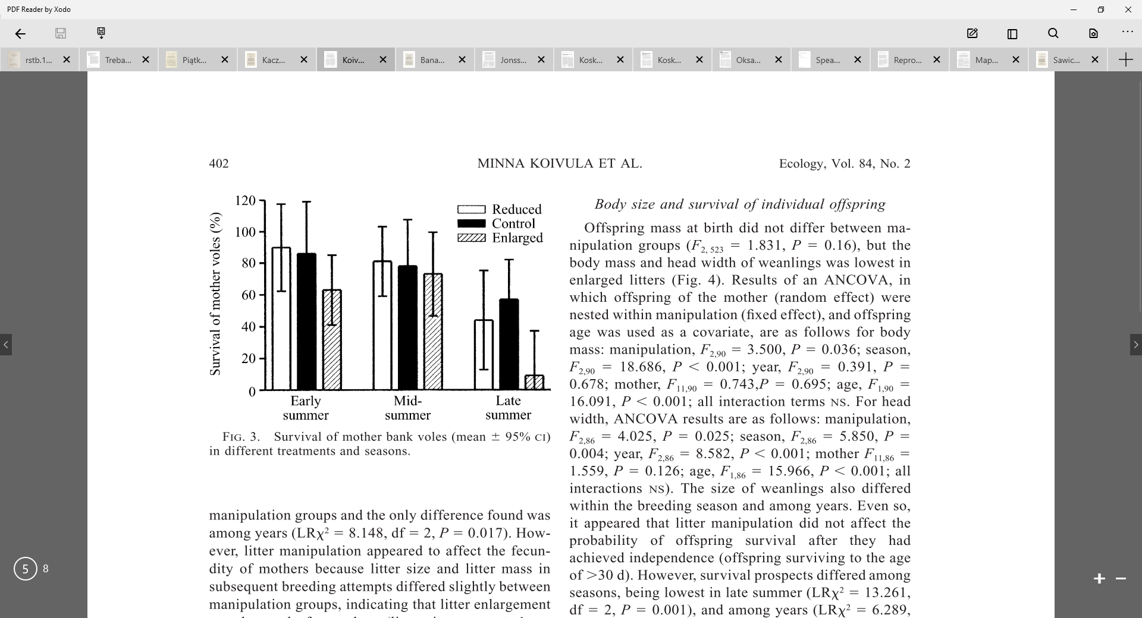
Lactation
Other useful patterns
Koivula et al. 2003
Johnson et al. 2002
Koskela 1998, Oksanen et al. 2001, Mappes et al. 1995

Slide 23
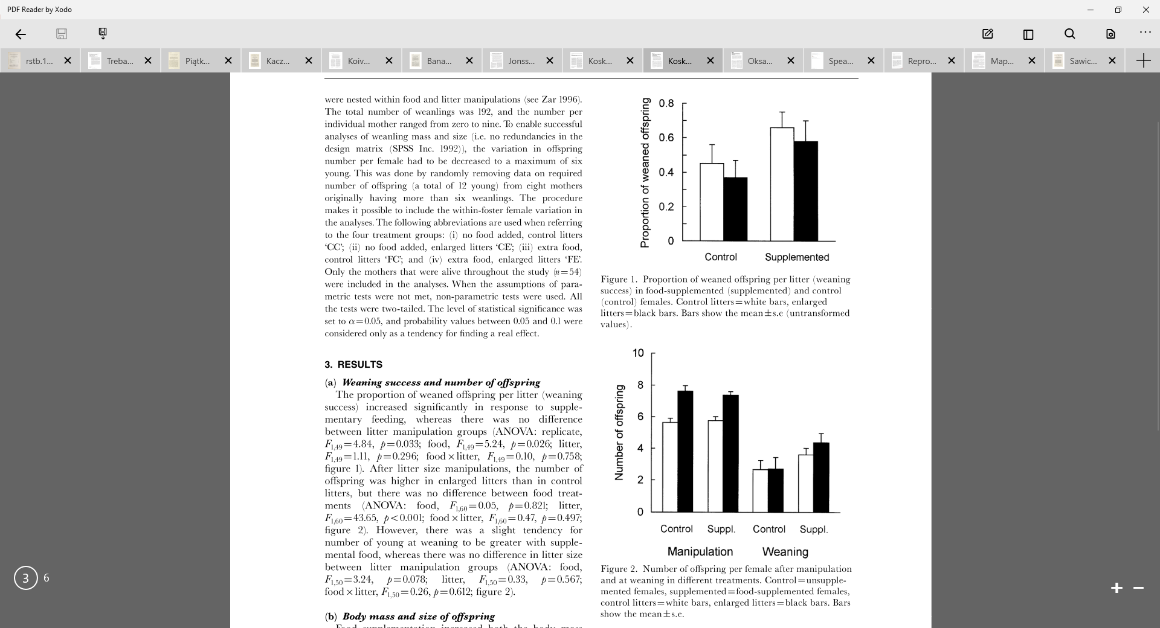
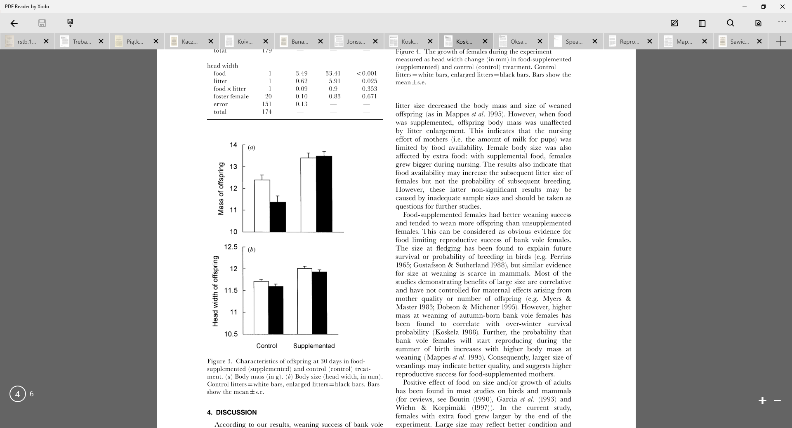
Lactation
Other useful patterns
Koskela et al. 1998
– food supplementation

Slide 24
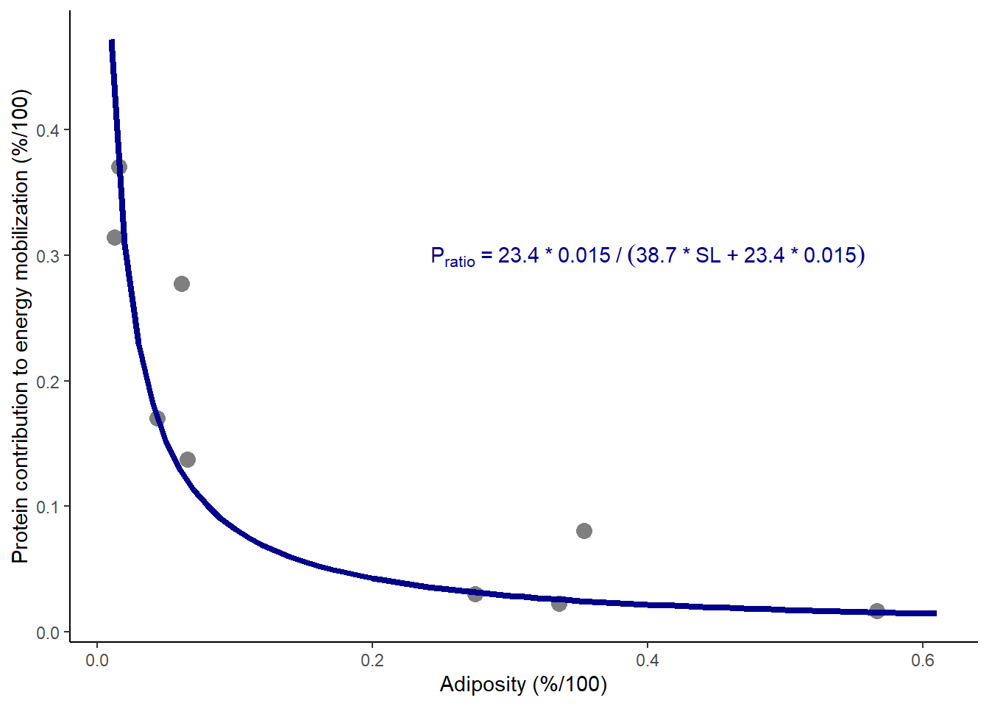
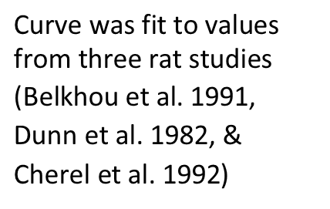
Storage
Mobilized and stored energy use a mix of protein and fat
$\text{Curve} \text{was} \text{fit} \text{to} \text{values} \text{from} \text{three} \text{rat} \text{studies}\text{ (}\text{Belkhou} \text{et} \text{al}\text{. }\text{1991}\text{, }\text{Dunn} \text{et} \text{al}\text{. }\text{1982}\text{, \& }\text{Cherel} \text{et} \text{al}\text{. }\text{1992}$)
Notes:
Based on the Forbes Theory - Hall 2007 - British Journal of Nutrition

Slide 25
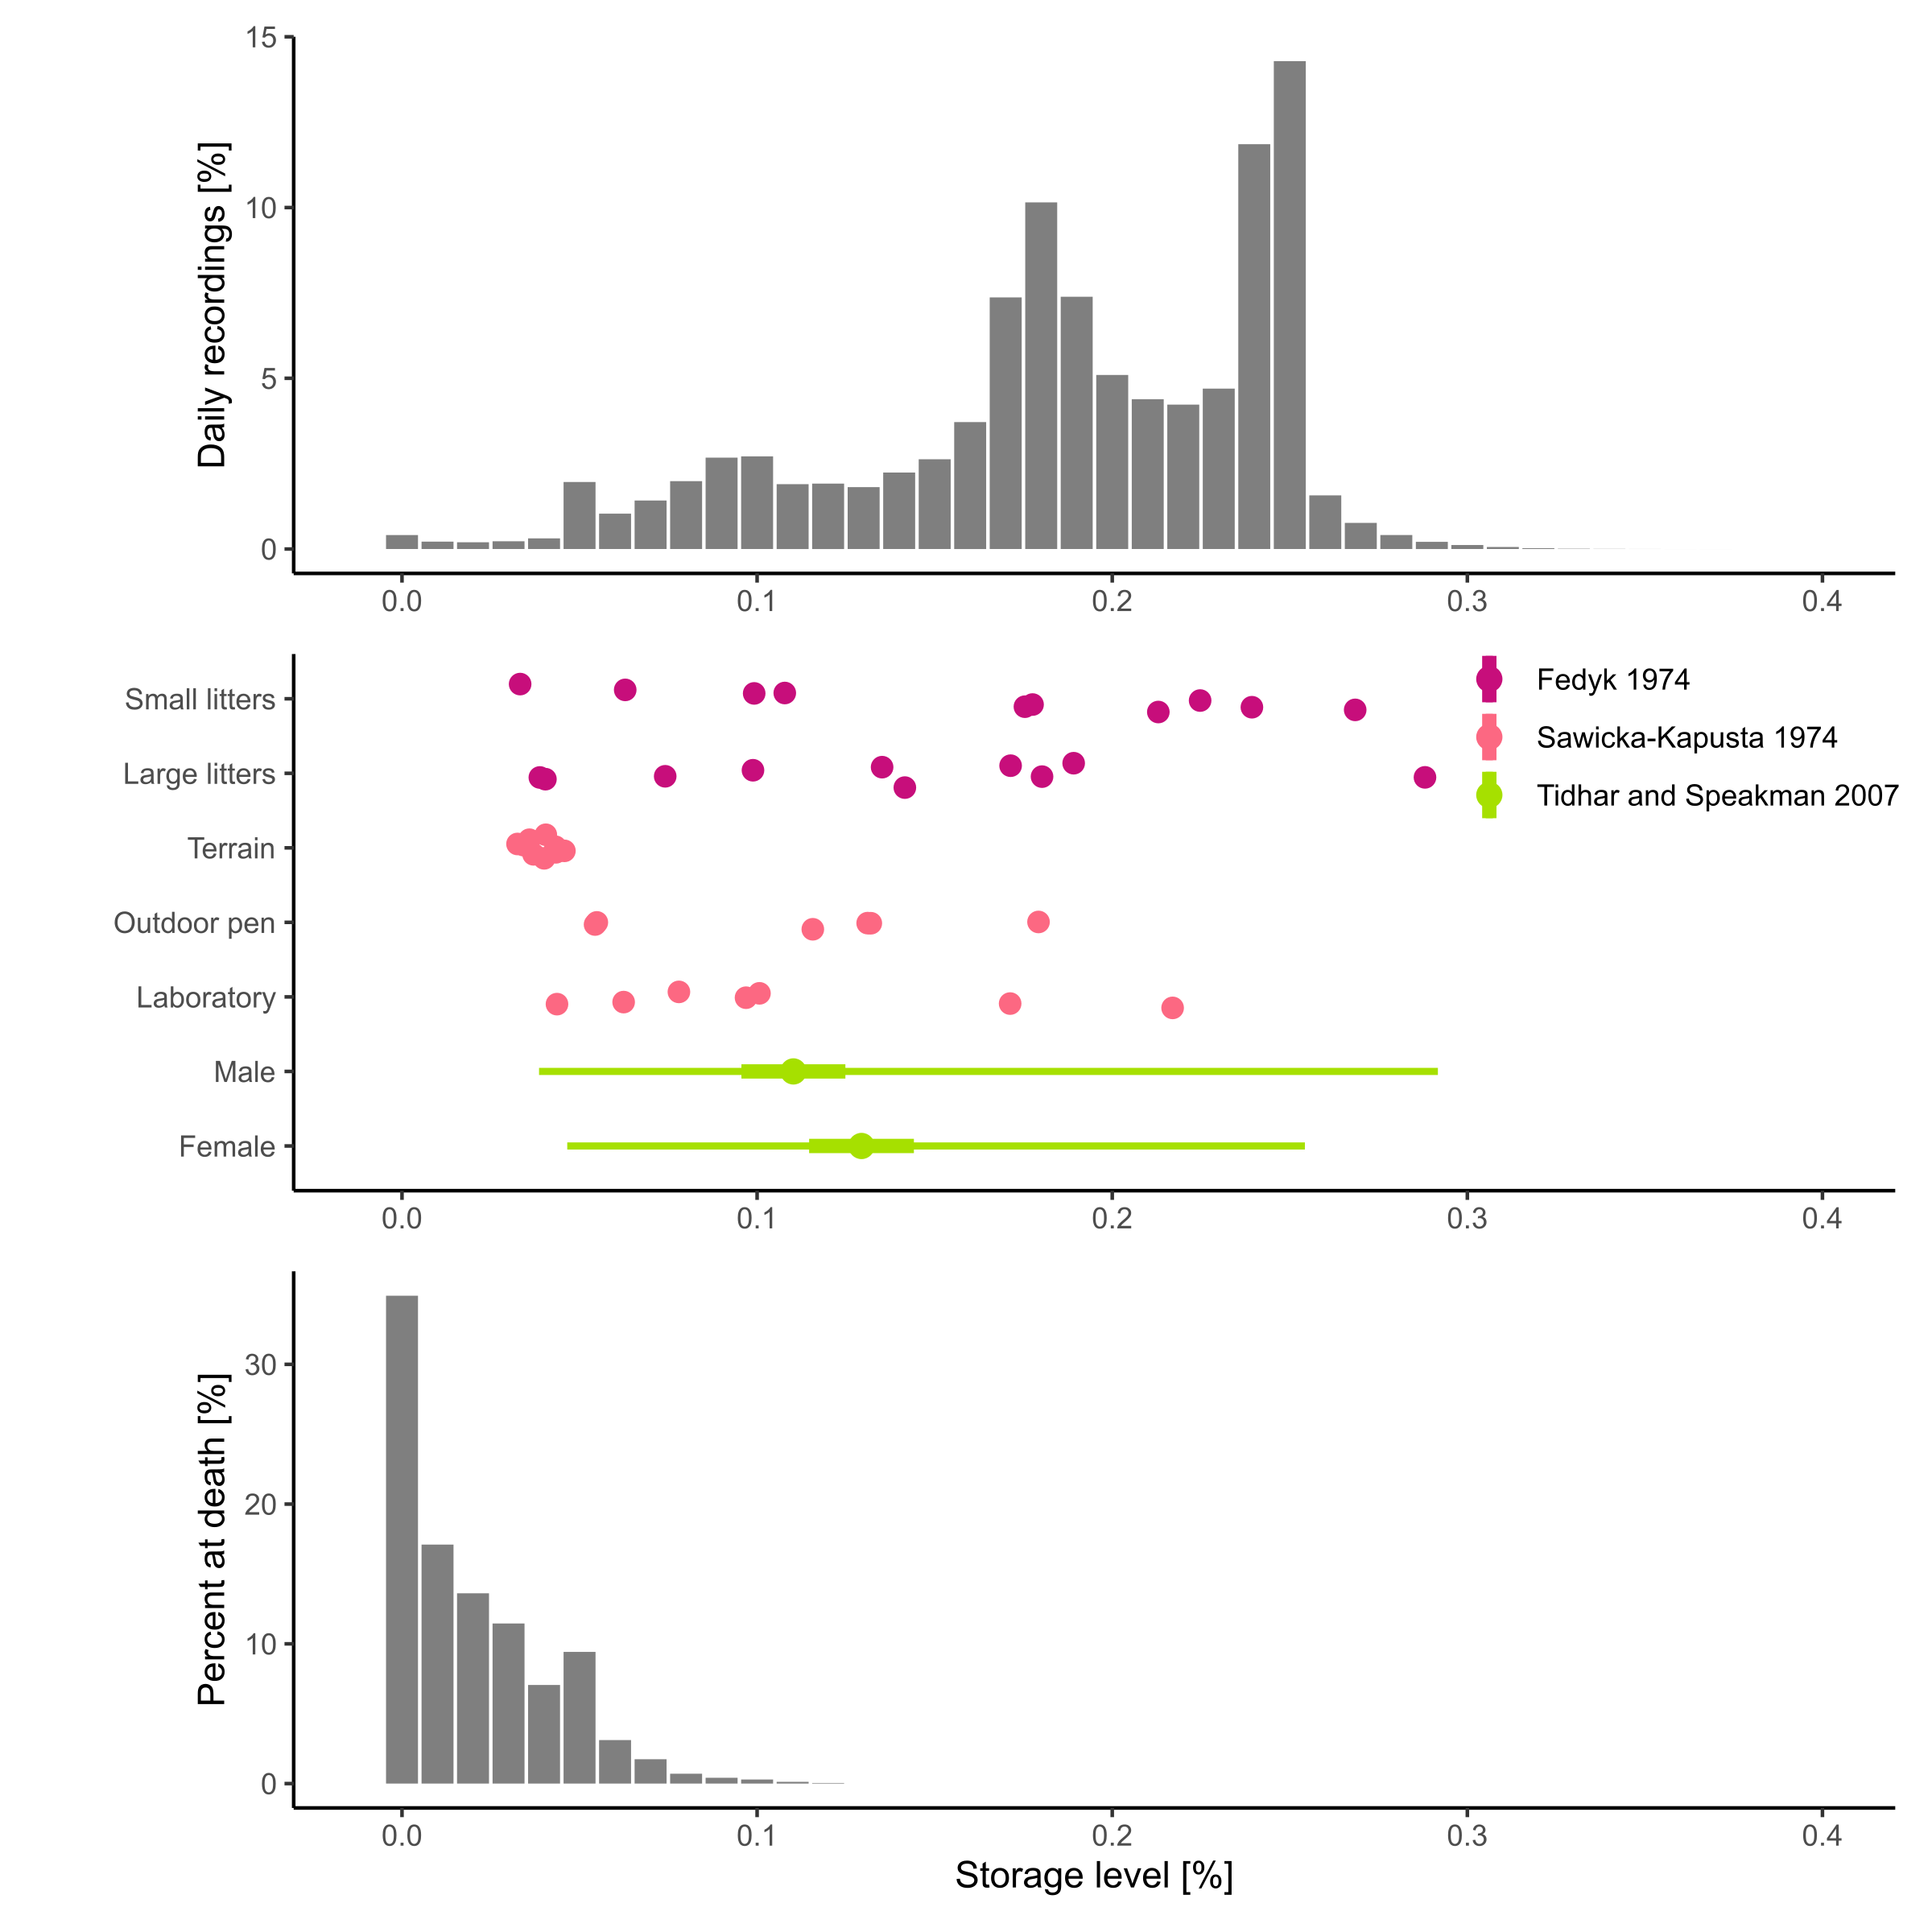
Storage

Slide 26



Storage

Slide 27



Energy allocation to Growth & Reproduction is affected by body fat
$$κ_{X}= \frac{1}{1+e^{−k_{X}\left(\frac{SL}{{SL}_{max}} − c_{X}\right)}}$$
Increased allocation
Survival probability is also modelled in this way
Used in Sibly et al. 2013 & DEB approaches (e.g. Nabe-Nielsen et al. 2018; Desforges et al. 2019)

Slide 28






Ingestion rate calculated in a timestep
$${IR}_{ts}=\frac{M−M_{HIF}}{AE×ED×\left(1−HIF\right)}$$
Ingestion rate can then be modified by storage level
$${IR}_{mod}=−1×{{SL}_{scaled}}^{3}+1$$
Increase
Reduce
Realized ingestion rate based on food available, ingestion rate, and maximum ingestion rate
To limit max ingestion, I tried a functional response curve but wasn’t flexible enough
- One maximum consumption value regardless of mass, age, reproductive status, etc.
Using maximum ingestion rate per unit body mass
- Based on Shipley et al. 1994
$${IR}_{max}=\left(0.63×m^{0.71}\right)×30$$
$${EA= IR}_{real}×AE×ED−M_{HIF}$$
Speakman 2014

Slide 29

Ingestion rate

Slide 30

Field metabolic rates
Rodents
Small mammals

Slide 31

Field metabolic rates

Slide 32

Field metabolic rates

Slide 33

Field metabolic rates

Slide 34

Population level

Slide 35

My vision
How does the environment shape the evolution of different metabolic phenotypes?
Generic & clear
Thoroughly evaluated
Novel
EB model

Slide 36
DEE
Mass
Notes:
240 Calories to 1 MJ

Slide 37


What’s this variation about?
19.6 - 22.4 MJ / day
(Rojano-Doñate et al. 2018)
© Fjord&Baelt
DEE
© Andrew Walmsley Photography
Mass
6.6 - 6.8 MJ / day (Pontzer et al. 2010)
Costs over 3x more for porpoises!
Notes:
240 Calories to 1 MJ

Slide 38
Question 1
How does the environment shape the evolution of different metabolic phenotypes?
From Bozinovic et al. 2007 on hypothesis re BMR variability:
“One of the most inclusive and yet debatable hypotheses is one that associates mass-independent BMR with diet. The food habits hypothesis identifies three components of the diet that can introduce variability into BMR: quality, availability, and predictability (Cruz-Neto and Bozinovic 2004). Specifically, the hypothesis posits that species or populations that exploit food with low energy content and/or low digestibility evolve low mass-independent BMRs (Cruz-Neto et al. 2001; McNab 2002). Likewise, the evolution of a low mass-independent BMR is likely to occur in habitats where food availability is low and/ or unpredictable (McNab 2002; Cruz-Neto and Jones 2005).”

Slide 39






How does the environment shape the evolution of different metabolic phenotypes?
Include inheritance of metabolic traits

Slide 40
My vision
How does the environment shape the evolution of different metabolic phenotypes?
How does individual variation in metabolic traits affect population dynamics and disturbance vulnerability?
How do energy management strategies impact population dynamics and disturbance vulnerability?
EB model

Slide 41
Energy budget verification summary
Overall many fits good, others give us something to think about
For now allocation and survival probabilities are arbitrarily selected – should be calibrated
Need population level patterns – e.g. cycles, densities, age-class structure

Slide 42
Full model current status
All animals are female
Wintertime skipping isn’t implemented
Movements are still basic
Landscape also still very basic ( patch size )

Slide 43
Going forward
What do you think of overall structure?
What are your thoughts for problems with activity and relationship between litter size and offspring mass?
More specific questions:
What about maximum metabolic rates?
Where makes sense to include individual variation? (maintenance costs, heat increment of feeding, assimilation efficiency)
Link between EB and pace of life?
Heritability of metabolic traits?
BMR depression with negative energy balance?
Notes:
240 Calories to 1 MJ

